Slide 1
Power Line EMI sensing
Date: 21st Jan, 2014

Slide 2
Goal
To study conducted EMI in power lines
Specific points to focus:
Effect of voltage fluctuation on CE.
Effect of building architecture on CE.
Analyze different CE signatures w/ and w/o load conditions.
CE signatures with different load settings on a single SMPS (EUT).
Difference in common mode CE and differential mode CE generated by appliances using CM and DM separation. [Added on 21/1/2014] [Imp.]
* CE: Conducted EMI

Slide 3
High Pass filter Circuit
Spec required :
50Khz to 30Mhz flat range
Should be capable to withhold 250VAC
components should be selected to work in RF range
Attenuator required at o/p to avoid high voltage signal from destroying analyzer front end.
Output impedance should be 50 Ohm to match with Signal analyzer input port.

Slide 4
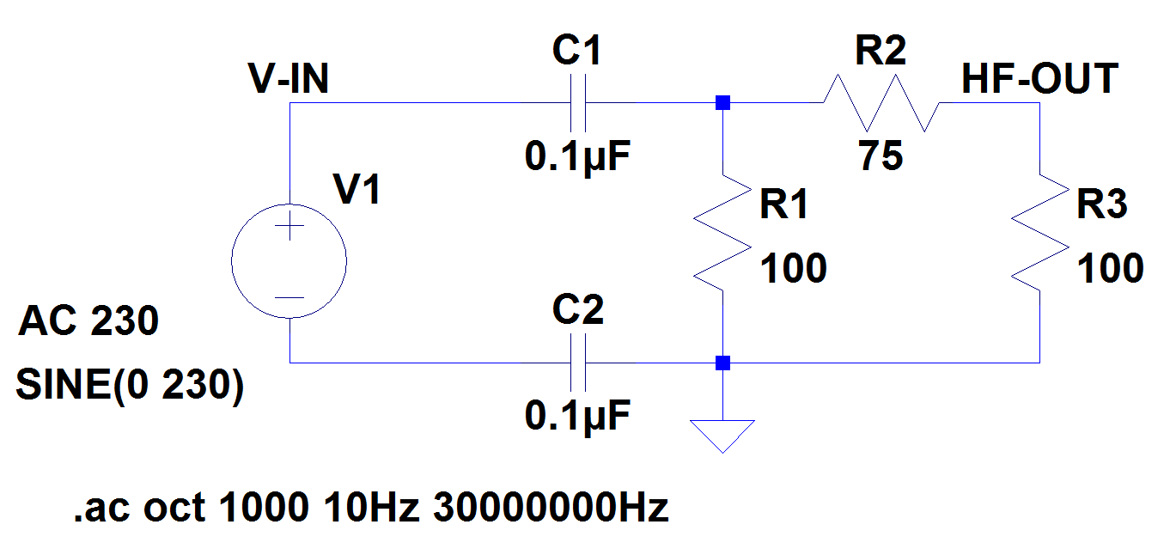
Simulated Circuit HPF

Slide 5
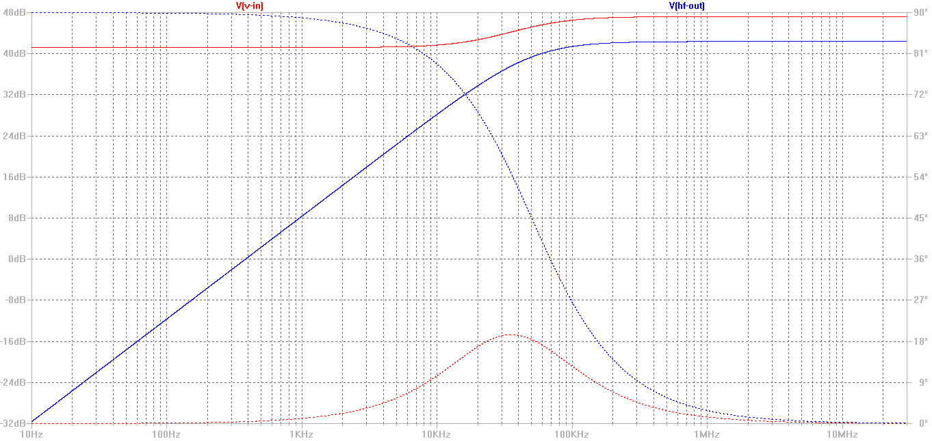
Frequency response

Slide 6
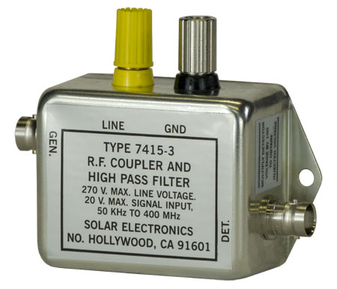
HPF Filter from Solar EMC (US)
URL: http://solar-emc.com/TEMP/7415-3.html

Slide 7
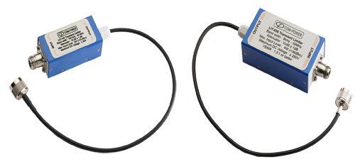
HPF filter from COM-Power
URL: http://www.com-power.com/transient_limiters.html

Slide 8
EMI testing Facility in Delhi
STQC lab {Standardisation Testing and Quality Certification}
http://www.stqc.gov.in/content/emiemc-testing
Key Areas:
http://www.stqc.gov.in/testing-key-areas/160/333
Lab in Okhla, Delhi
ERTL(North) Delhi
Head of Laboratory | M P Sharma (Sr. Director) | ERTL(North) S- Block, Okhla Industrial Area, Phase - II, New Delhi - 110020 | Tel.: 011 - 26386219 Fax: 011 - 26384583 Email: mpsharma AT stqc.nic.in

Slide 9
EMI Testing GB pant College
GB pant engineering college, Okhla (Delhi) is having good microwave, EMI/EMC testing labs.
Link: www.sltmicrowave.com/doc_pdf/EMIEMC%20Test%20Facility.pdf

Slide 10
References
Power Line Filter Design for Conducted Electromagnetic Interference Using Time-Domain Measurements (Link to PDF).

Slide 11
Conclusions
Setup a test bed for CE testing without wasting much time on designing HPFs.
Look for off the shelf components and facilities available nearby.
Simulate a generic SMPS model for modeling noise from different appliances.
Study 2-3 research papers and prepare presentation for weekly meeting. Document each and every discussion.
*CE: Conducted EMI

